Slide 1
purifAI
Machine Learning for SPE Method Prediction
Created by Jen Amis, Luke Perrin, Teresa Tran, Yingying Cheung

Slide 2
Overview
The team at an automated chemistry platform that works to automate the process of making small chemical compounds to be used in research and development for medicinal purposes is seeking a machine learning model that can be used to select the best SPE method to test for purification of each chemical compound in a large library of compounds.
Without a ML model that can effectively predict the optimal SPE method to use, the team must make a best guess of which method to test based on a subset of properties of each compound’s structure. This process can be time consuming and expensive, especially if the wrong SPE method ends up being selected and the purification testing must be repeated using the other method.
Development of a ML model has the potential to save time & cost effective in the automated chemistry platform’s process.

Slide 3
Goals
1
Identify features and target for ML model
2
Identify a ML model with best prediction performance for SPE and LCMS method
3
Test the confidence level
4
Create an interactive User Interface for public

Slide 4

Data Source
This project utilizes datasets provided by the data team at the automated chemistry platform. The first dataset lists compounds tested by the platform over the past two years and includes compound properties such as molecular weight, topological polar surface area (TPSA), quantitative estimate of drug-likeness (QED), among many others that may be relevant to predicting the appropriate SPE method to use for compound purification. The second dataset includes the status of testing for each compound and the SPE method used for each compound that has completed the purification stage. Each compound is identified by a unique structure ID, and proprietary information about the actual structure of the compound has been excluded from the datasets.

Slide 5

Database
A relational database (RDS) was created in Amazon Web Services (AWS), and connected to pgAdmin14. This Postgres database is hosted on the cloud, which can be accessed by anyone with credentials using pgAdmin14. Data was cleaned by Pandas, and stored in AWS S3 bucket. We call the data from RDS by using SQLAlchemy.

Slide 6
MACHINE LEARNING

Slide 7
DATA EXPLORATION

Slide 8
ML MODEL
Balanced Random Forest
Easy Ensemble AdaBoost
XGBoost
SMOTE Oversampling
Random Undersampling
Cluster Centroids Undersampling
Random Oversampling
SMOTEENN over and undersampling

Slide 9
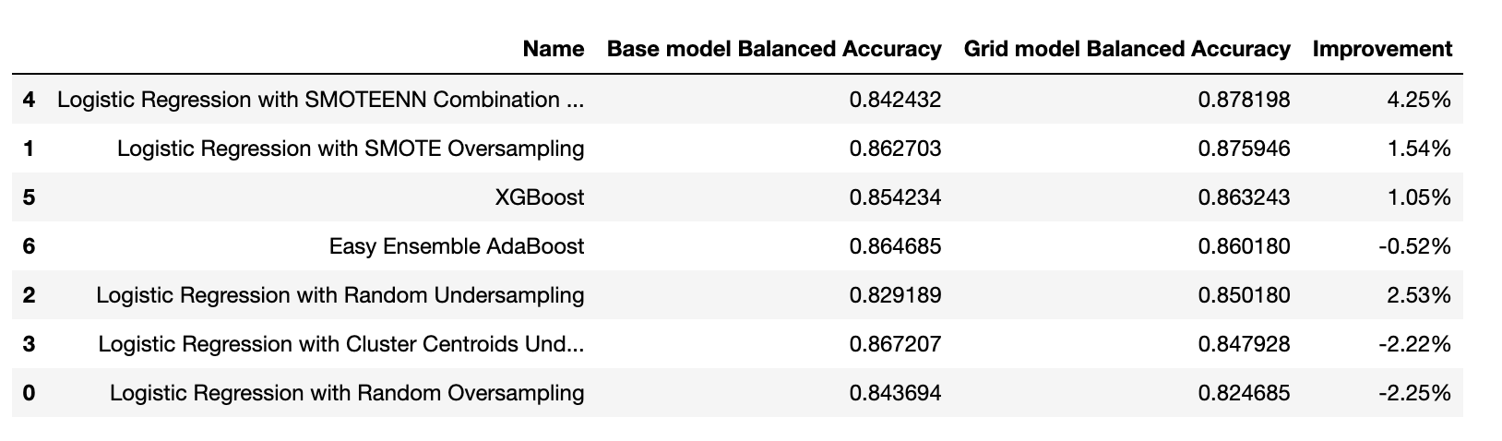

Slide 10
DATA ANALYSIS

Slide 11
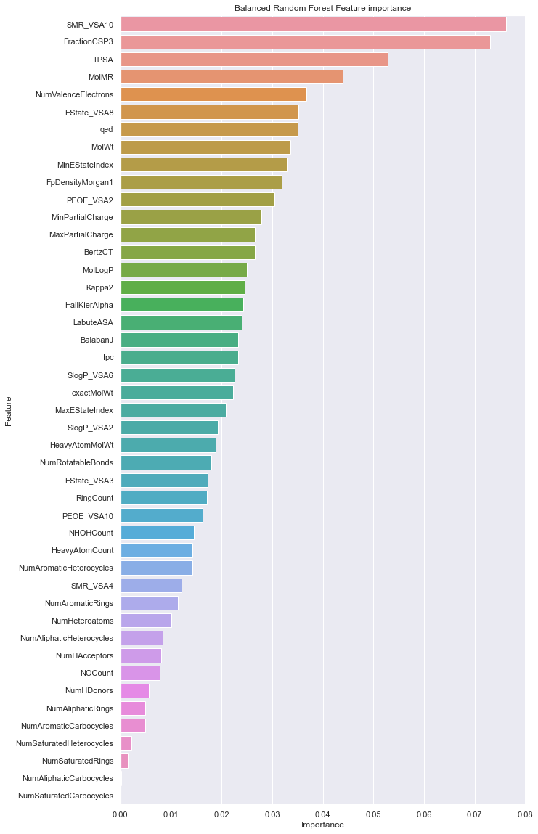
Top 20

Slide 12
Confidence Level

Slide 13
DASHBOARD

Slide 14
SMILE

Slide 15
Questions?

